Slide 1


NeuroLink – AI Mental Fitness Companion
High Stress. Low Focus. Generic Solutions.
The Challenge
Students and professionals are facing rising stress and anxiety
Emotional imbalance reduces focus and productivity
Current wellness apps provide generic advice, not personalization
Our Solution – NeuroLink
AI that understands emotions in real time
Smart, personalized productivity and wellness suggestions
Continuous insights to help users stay focused and balanced
Empower your mind — one mood at a time.

Slide 2
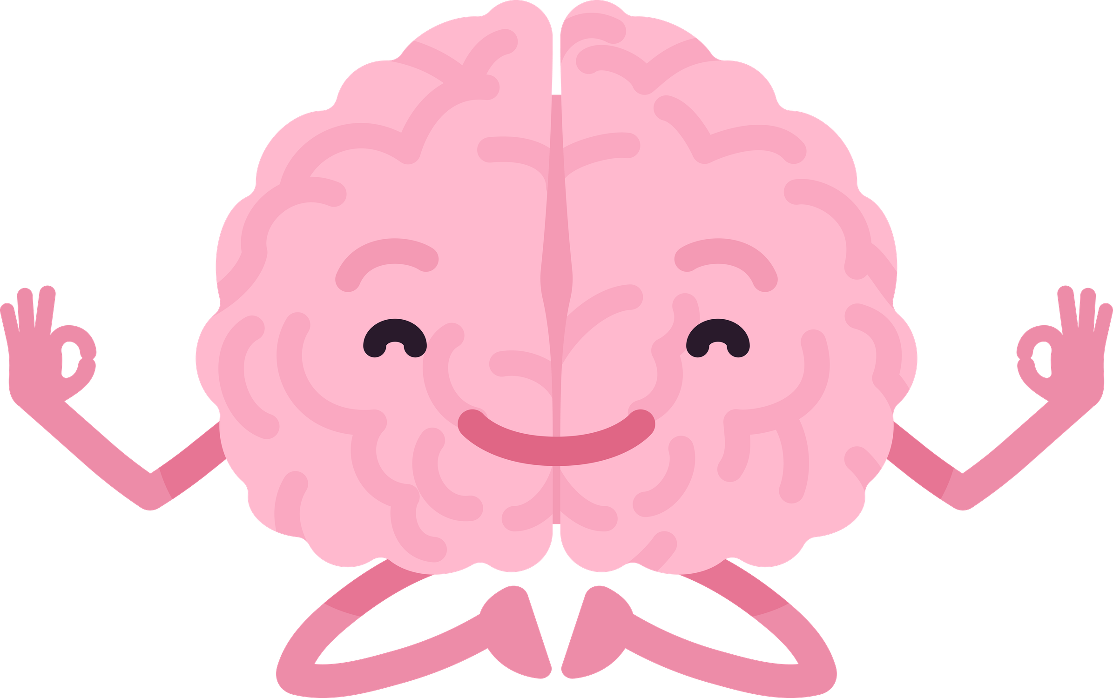

From Mood to Meaning: How NeuroLink Works
AI Workflow
User Input → Mood Detection → Smart Suggestions → Dashboard Insights → AI Chat Support → Psychologist Support (if needed)
Core Technologies
Natural Language Processing (NLP)
Sentiment Analysis & Machine Learning
Streamlit Web Platform
Conversational AI
Support System
AI Support: Instant mood analysis, focus tips, and motivational guidance
Psychologist Support: Option to connect users with professionals in high-stress cases
Key Highlight
Real-time mood analysis and personalized recommendations to improve focus, productivity, and mental well-being.

Slide 3


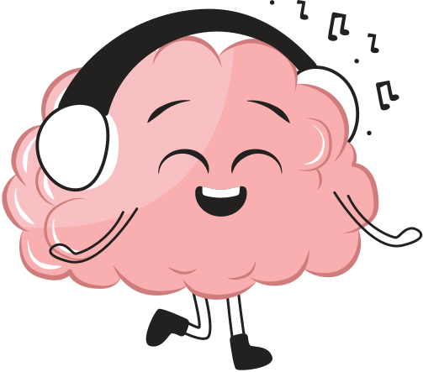
Impact, Novelty & Future Scope
Impact
Improves focus and productivity
Helps users understand emotional patterns
Supports better mental well-being and self-awareness
What Makes NeuroLink Unique
Real-time emotion-aware productivity suggestions
Personalized AI recommendations based on mood
Integrated system: analytics + chatbot + mood tracking + AI support
Future Scope
Voice-based mood detection
Wearable device integration (smartwatch, health sensors)
AI-generated daily mental fitness plans
Optional psychologist support integration for high-stress cases
Not just a mood tracker — an AI decision assistant for mental fitness.

